Slide 1

Delicious Pizza for Everyone!
PIZZA SALES ANALYSIS

Slide 2



Hello!
I am Pravesh Gangwar, In this Pizza Sales Project, I utilized SQL queries to address various questions pertaining to pizza sales data. My role involved analyzing the dataset and extracting insights using SQL queries to understand sales trends, customer preferences, and other relevant metrics.

Slide 3
Data Model

Slide 4
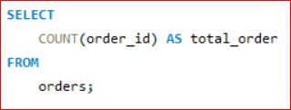

Retrieve the total number of orders placed.

Slide 5
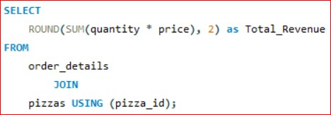

Calculate the total revenue generated from pizza sales.

Slide 6
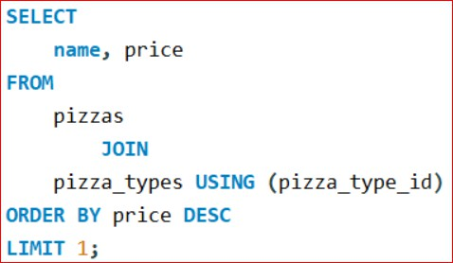

Identify the highest-priced pizza.

Slide 7
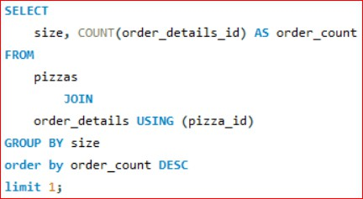

Identify the most common pizza size ordered.

Slide 8
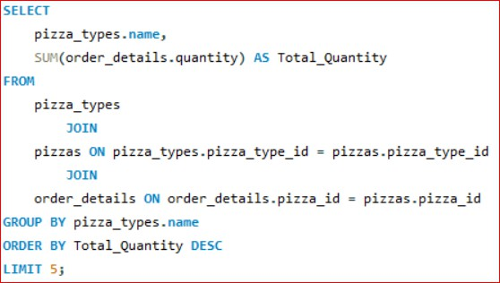
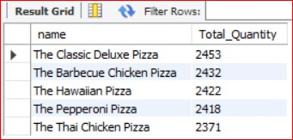
List the top 5 most ordered pizza types along with their quantities.

Slide 9
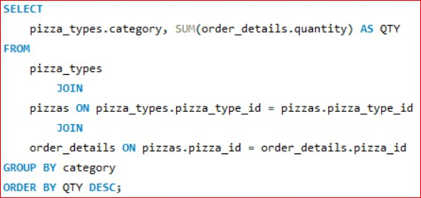
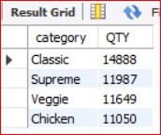
Join the necessary tables to find the total quantity of each pizza category ordered.

Slide 10
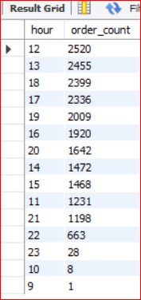
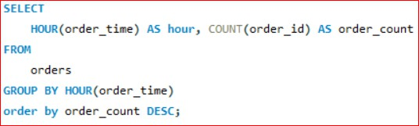
Determine the distribution of orders by hour of the day.

Slide 11
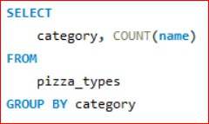
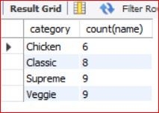
Join relevant tables to find the category-wise distribution of pizzas.

Slide 12
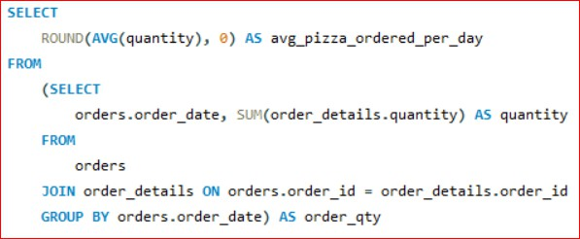

_{c} Group the orders by date and alculate the average number of
pizzas ordered per day.

Slide 13
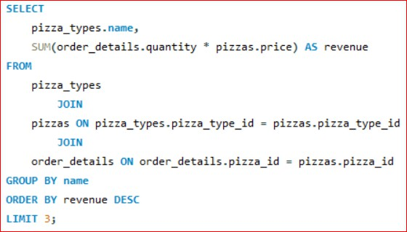
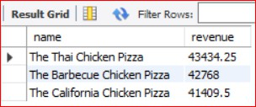
Determine the top 3 most ordered pizza types based on revenue.

Slide 14
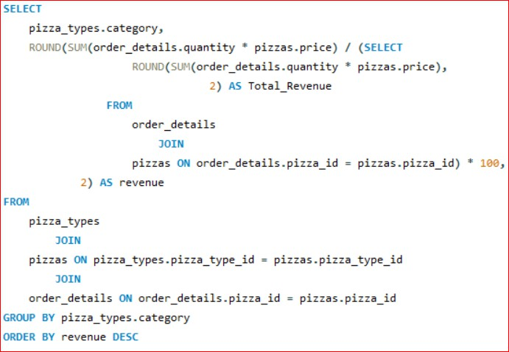
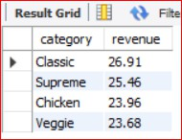
_{con} Calculate the percentage tribution of each pizza type to
total revenue.

Slide 15
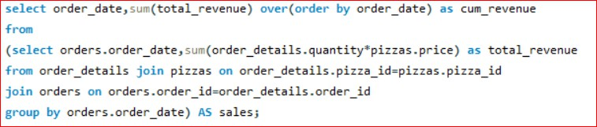
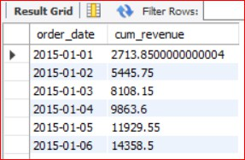
Analyze the cumulative revenue generated over time.

Slide 16
THANK
YOU
aryangahoi12345@gmail.com

